Slide 2
Descriptive mining
Descriptive mining is usually used to provide correlation, cross-tabulation, frequency, etc.
These techniques are used to determine the data regularities and to reveal patterns.
It targets the summarization and conversion of data into meaningful data for reporting and monitoring.
As the name suggests, descriptive mining "describe" the data.
Once the data is captured, we convert it into human interpretable form.
Descriptive analytics focus on answering "What has happened in the past?" Descriptive analytics is useful because it enables us to learn from the past.

Slide 3
Predictive data Mining
The term 'Predictive' means to predict something, so predictive data mining is the analysis done to predict the future event or other data or trends.
Predictive data mining can enable business analysts to make decisions and add value to the analytics team efforts.
Predictive data mining supports predictive analytics.
As we know, predictive analytics is the use of information to predict outcomes.

Slide 4
Example
Any retail shop may use algorithm-based tools to go through a customer database to look at the previous transactions to predict future transactions.
In other words, the previous data may enable the shopkeeper to project what will happen in future in the business, enabling business people to plan accordingly.

Slide 5
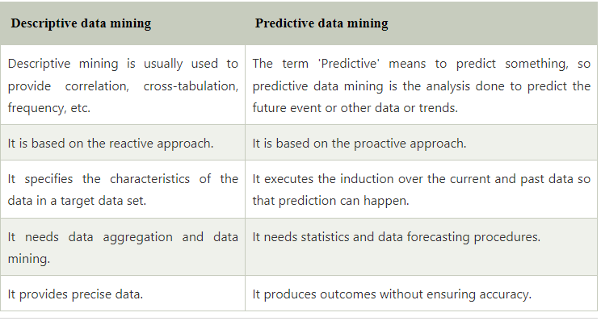
Compare

Slide 6
Data Warehouse vs. Operational DBMS
OLTP (on-line transaction processing)
Major task of traditional relational DBMS
Day-to-day operations: purchasing, inventory, banking, manufacturing, payroll, registration, accounting, etc.
OLAP (on-line analytical processing)
Major task of data warehouse system
Data analysis and decision making
Distinct features (OLTP vs. OLAP):
User and system orientation: customer vs. market
Data contents: current, detailed vs. historical, consolidated
Database design: ER + application vs. star + subject
View: current, local vs. evolutionary, integrated
Access patterns: update vs. read-only but complex queries

Slide 7
OLTP vs. OLAP

Slide 8
Multi-Dimensional Data Model
A multidimensional model views data in the form of a data-cube.
A data cube enables data to be modeled and viewed in multiple dimensions.
It is defined by dimensions and facts.
The dimensions are the perspectives or entities concerning which an organization keeps records.

Slide 9
Example
A shop may create a sales data warehouse to keep records of the store's sales for the dimension time, item, and location.
These dimensions allow the save to keep track of things, for example, monthly sales of items and the locations at which the items were sold.
Each dimension has a table related to it, called a dimensional table, which describes the dimension further.
For example, a dimensional table for an item may contain the attributes item_name, brand, and type.

Slide 10
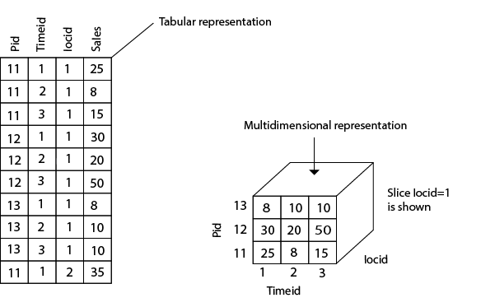
Example

Slide 11
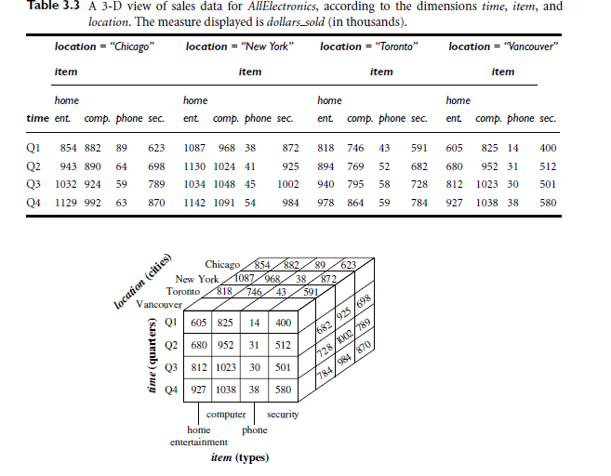
Example

Slide 12
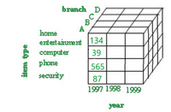
Data cube
The Data cube pictorially shows how different attributes of data are arranged in the data model.

Slide 13
Data cube operations
Roll-up: operation and aggregate certain similar data attributes having the same dimension together.
For example, if the data cube displays the daily income of a customer, we can use a roll-up operation to find the monthly income of his salary.
Drill-down: this operation is the reverse of the roll-up operation.
It allows us to take particular information and then subdivide it further for coarser granularity analysis.
It zooms into more detail.
For example- if India is an attribute of a country column and we wish to see villages in India, then the drill-down operation splits India into states, districts, towns, cities, villages and then displays the required information.

Slide 14
Data cube operations
Slicing: this operation filters the unnecessary portions. Suppose in a particular dimension, the user doesn’t need everything for analysis, rather a particular attribute.
For example, country=”jamaica”, this will display only about jamaica and only display other countries present on the country list.
Dicing: this operation does a multidimensional cutting, that not only cuts only one dimension but also can go to another dimension and cut a certain range of it. For example- the user wants to see the annual salary of Jharkhand state employees.

Slide 15
Fact Table and Dimension Table
A fact table’s record could be a combination of attributes from totally different dimension tables.
The Fact Table helps the user to investigate the business dimensions that helps him in call taking to enhance his business.
On the opposite hand, Dimension Tables facilitate fact table to gather dimensions on that the measures needs to be taken.

Slide 16
Conceptual Modeling of Data Warehouses
Modeling data warehouses: dimensions & measures
Star schema: A fact table in the middle connected to a set of dimension tables
Snowflake schema: A refinement of star schema where some dimensional hierarchy is normalized into a set of smaller dimension tables, forming a shape similar to snowflake
Fact constellations: Multiple fact tables share dimension tables, viewed as a collection of stars, therefore called galaxy schema or fact constellation

Slide 17
Example of Star Schema
time
time_key
day
day_of_the_week
month
quarter
year
item
item_key
item_name
brand
type
supplier_type
Sales Fact Table
time_key
item_key
branch_key
branch
location
location_key
branch_key
branch_name
branch_type
location_key
street
city
state_or_province
country
units_sold
dollars_sold
avg_sales
Measures

Slide 18
Example of Snowflake Schema
time
item
time_key
day
day_of_the_week
month
quarter
year
item_key
item_name
brand
type
supplier_key
supplier
Sales Fact Table
supplier_key
supplier_type
time_key
item_key
branch_key
branch
location
location_key
location_key
street
city_key
branch_key
branch_name
branch_type
units_sold
dollars_sold
city
city_key
city
state_or_province
country
avg_sales
Measures

Slide 19
Example of Fact Constellation
time
time_key
day
day_of_the_week
month
quarter
year
item
Shipping Fact Table
item_key
item_name
brand
type
supplier_type
Sales Fact Table
time_key
time_key
item_key
shipper_key
item_key
branch_key
from_location
branch
location_key
location
to_location
branch_key
branch_name
branch_type
units_sold
location_key
street
city
province_or_state
country
dollars_cost
dollars_sold
units_shipped
avg_sales
shipper
Measures
shipper_key
shipper_name
location_key
shipper_type

